Slide 1
How Much is Your Home Worth?
July 10, 2020

Slide 2
Project objective:
Accurately predict consumer home price.
Notes:
We have been hired to create a consumer-facing product that will predict the home value of any resident of King County, Washington. Objective is to drive traffic for King’s County real estate searches through the simplicity and effectiveness of our prediction tool. Users should input a limited number of known descriptors of their house, as well as basic contact information output will be a price range and real estate associate point of contact.

Slide 3

The Data
Sources:
King County Government - House Data
King County GIS Open Data Platform - Location Data
Details:
21k houses sold between May 2014 and May 2015.
Houses valued between $100k and $1m.

Slide 4

Limitations
Sales data has not been adjusted for inflation.
Model does not explain all variation in price.
We assume our product has access to user location data.
Assume home renovations in data are significant.

Slide 5
Understanding the Pricing Problem
Does Location Matter?
Does Size Matter?
Does Quality Matter?
Is a house inside the city of Seattle worth more than one in the suburbs?
Are homes in top school districts valued more highly?
Are larger homes worth more?
Square footage, number of rooms, floors, etc.
Is the architecture of high quality?
Are the construction materials high quality?
When was the house built (or last renovated)?

Slide 6
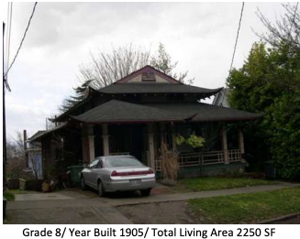
How Much is My House Worth?
Properties:
2 bedrooms
1.5 floors
1.5 bathrooms
2,250 square feet
Grade 8
Condition 2
How to these factors influence house price in general?

Slide 7
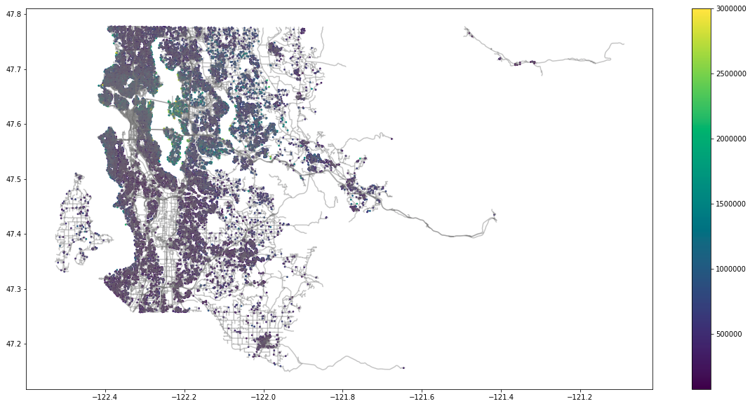
Location
Homes with high values are clustered in certain areas.
Possible Factors:
City
School District
Waterfront

Slide 8
Location
School District
Top public school districts are Mercer Island, Lake Washington, Snoqualmie, Bellevue, and Issaquah.
Implications:
A home in a top district is worth ~$180k more than one in a lower-ranked district, all else equal.
City
Homes in Seattle are worth ~$210k more than homes outside of the city, all else equal.
Waterfront
Waterfront homes are worth ~$480k more than inland homes, all else equal.

Slide 9
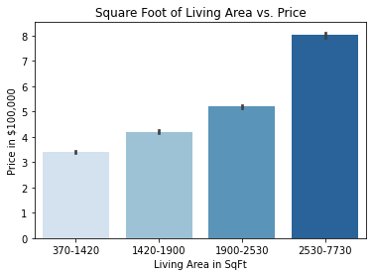
Home Size
There is a wide range of home types in King County.
Factors:
Square Foot Total
Number of Bedrooms
Number of Bathrooms
Number of Floors

Slide 10
Home Size
Square Footage
Each square foot of space increases a home’s value by about $140, all else equal. However, it matters where the space increase is in the home.
Client Implications:
Basement space is worth less than above ground space.
Rooms & Floors
Not all spaces are equally valued.
Client Implications:
Having more bedrooms can mean a lower home value.
A 2 floor home is worth less than other layouts.

Slide 11
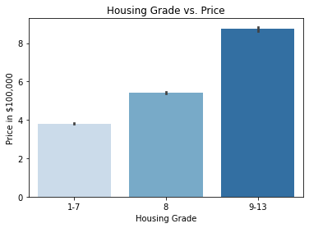
Quality
Grade:
1-13 scale. ‘Average’ house is rated 7.
Factors
Architectural design quality
Construction quality.
Compliance with KC building codes.
Building materials.
Condition:
1-5 scale. ‘Average’ house is rated 3.
Factors include quality of maintenance, amount of repairs needed, and age of the home.

Slide 12
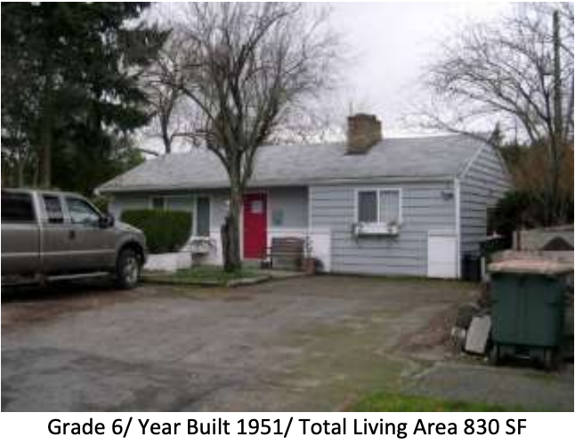
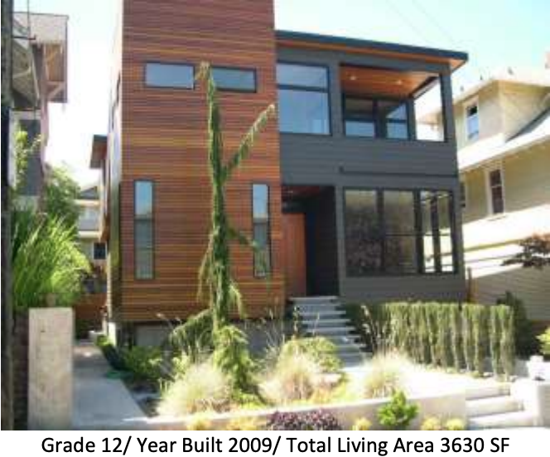
Quality & Condition
Grade
A highly rated house has greatly increased value when compared to an average house. Architecture and build quality matter!
Condition
Above average condition ratings increase the value of a home. Lower condition ratings have a smaller effect.
Client Implications:
Investing in maintenance can pay off when selling a home.
Notes:
High Grade/Condition impact a home more than low grade/condition compared to the average home.

Slide 13
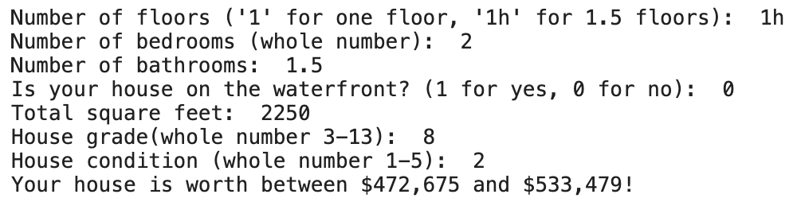
How Much is My House Worth?
Model Output:

Slide 14
Takeaways
Location
City of Seattle
Top School District
Waterfront
Season
Homes sell for more in the spring.
Quality & Condition
Invest in high quality maintenance of the home.
Quality of design & architecture are important.
Rooms & Floors
Bedrooms are less valuable.
Different floor plans have different values.
Square Footage
Above ground space is more important than basement size
Large increases in square feet lead to increased valuations
Notes:
Assume we already know season, is_seattle, and top_5_district

Slide 15
Further Research
Our model does not explain all variance in price for King County homes. With more data, more accurate predictions would be possible.
Improve Predictions
Are different factors valuable in Seattle vs the suburbs?
Trends in housing prices over time - dataset is outdated
Test potential additional models / cross-validate
Additional Factors
Create User Interface
Deploy tool to consumers.

Slide 16
Questions?

